Slide 1

Name: Govind Jangid
IT TOOLS PRESENTATION
Topic : Zoom
Roll no.115

Slide 2
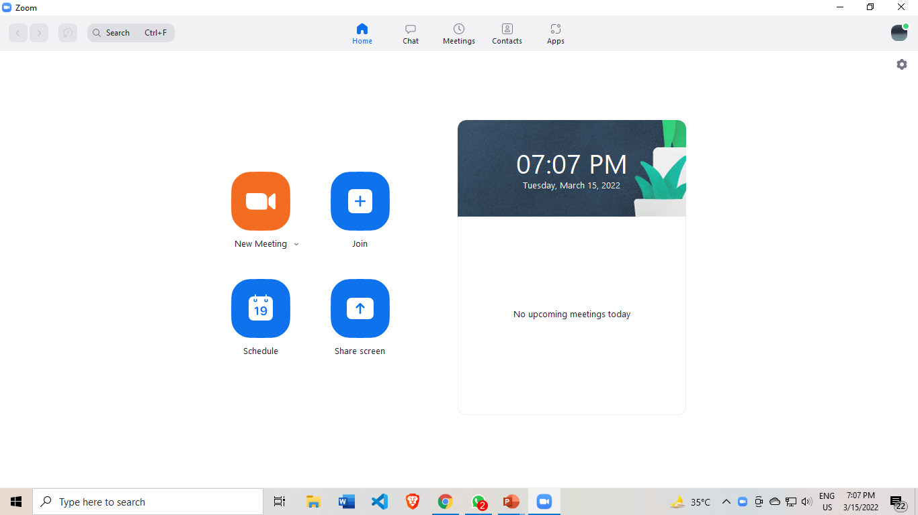

Slide 3
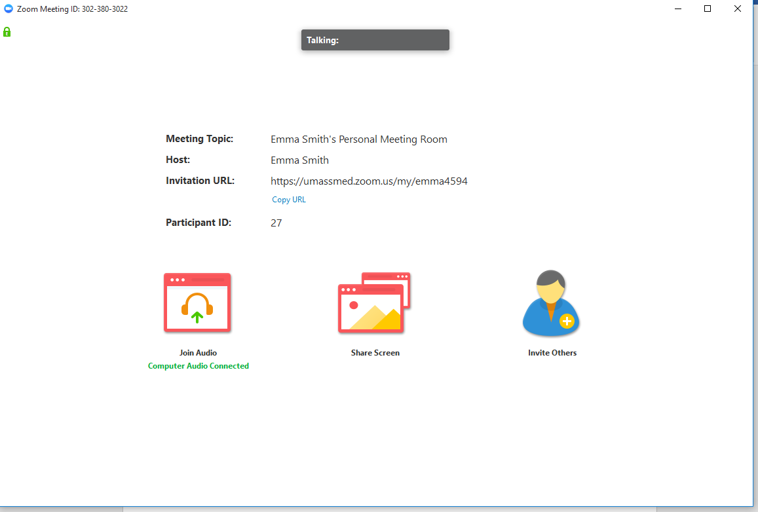
In Meeting Controls Meeting Interface
In Meeting Control Bar

Slide 4

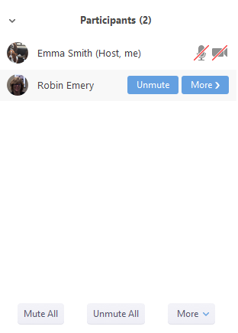
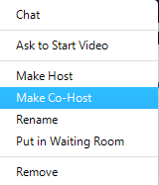
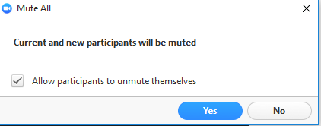

In Meeting Controls Participant Controls

Slide 5
What is Zoom and how does it work?
Zoom allows one-to-one chat sessions that can grow into group calls,
training sessions and webinars for internal and external audiences,
and global video meetings with up to 1,000 participants and as many as
49 on-screen videos.
Thank you

